Slide 1
CRUD – Crate, Read, Update, Delete

Slide 2
CRUD operation :
The CRUD stands for Create, Read/Retrieve, Update, and Delete. These are the four basic functions of the persistence storage.
The CRUD operation can be defined as user interface conventions that allow view, search, and modify information through computer-based forms and reports.
CRUD is data-oriented and the standardized use of HTTP action verbs.
HTTP has a few important verbs.
POST: Creates a new resource
GET: Reads a resource
PUT: Updates an existing resource
DELETE: Deletes a resource

Slide 3
Standard CRUD Operation:
CREATE Operation: It performs the INSERT statement to create a new record.
READ Operation: It reads table records based on the input parameter.
UPDATE Operation: It executes an update statement on the table. It is based on the input parameter.
DELETE Operation: It deletes a specified row in the table. It is also based on the input parameter.
Operation | SQL | HTTP verbs | RESTful Web Service
Create | INSERT | PUT/POST | POST
Read | SELECT | GET | GET
Update | UPDATE | PUT/POST/PATCH | PUT
Delete | DELETE | DELETE | DELETE

Slide 4
CrudRepository vs. JpaRepository:
CrudRepository | JpaRepository
CrudRepository does not provide any method for pagination and sorting. | JpaRepository extends PagingAndSortingRepository. It provides all the methods for implementing the pagination.
It works as a marker interface. | JpaRepository extends both CrudRepository and PagingAndSortingRepository.
It provides CRUD function only. For example findById(), findAll(), etc. | It provides some extra methods along with the method of PagingAndSortingRepository and CrudRepository. For example, flush(), deleteInBatch().
It is used when we do not need the functions provided by JpaRepository and PagingAndSortingRepository. | It is used when we want to implement pagination and sorting functionality in an application.

Slide 5
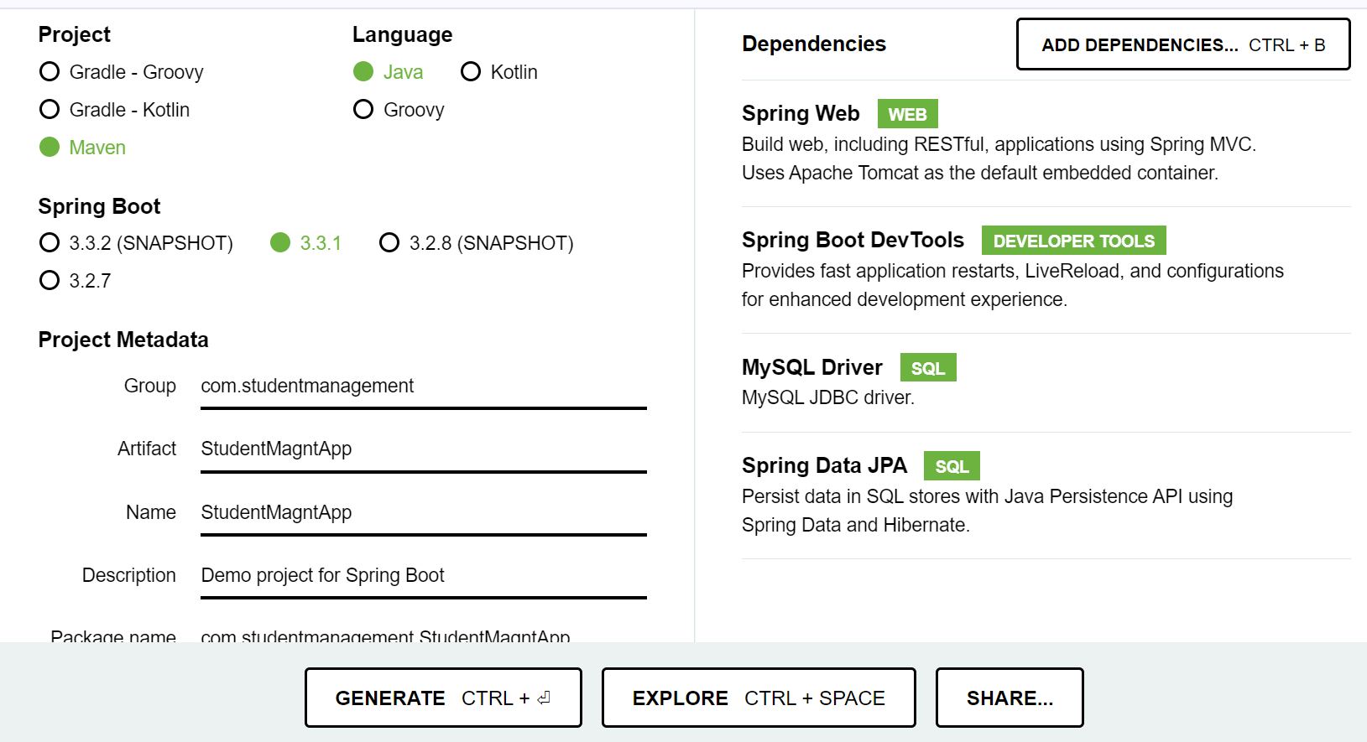
Spring boot CRUD operation Example:
Open Spring Initializr http://start.spring.io.
Add denpendencies:
spring dev tool
spring web
mysql driver
springboot data JPA
Click GENERATE CTRL+

Slide 6
One zip file will generate & download →Extract it → open it in Intellij → Open pom.xml file
Make chages Like ,
version : 2.7.14, java version : 8
<plugin>
<groupId>org.apache.maven.plugins</groupId>
<artifactId>maven-surefire-plugin</artifactId>
<version>2.22.2</version>
<configuration>
<skipTests>true</skipTests>
</configuration>
</plugin>
Every chage give save all → clean → install
Delete 'Test' folder and restart ( file → invalid caches → restart )
open xamp server → create database
Go resources → Application properties → type following code

Slide 7
spring.application.name=StudentMagmtApp ( only this line default )
server.port=9091
spring.datasource.url=jdbc:mysql://localhost:3306/MyDb
spring.datasource.username=root
spring.datasource.password=
spring.datasource.driver-class-name=com.mysql.jdbc.Driver
spring.jpa.show-sql=true
spring.jpa.hibernate.ddl-auto=update
spring.jpa.properties.hibernate.dialect=org.hibernate.dialect.MySQL5InnoDBDialect
Create package ( name - entity) → create java class (name - Student) → type follow code

Slide 8
Program:
package com.studentmanagement.StudentMagmtApp.entity;
import javax.persistence.*;
@Entity
@Table(name = "student")
public class Student {
@Id
@GeneratedValue(strategy = GenerationType.IDENTITY)
@Column(name = "student_id")
private long id;
@Column(name = "student_name")
private String name;
@Column(name = "student_branch")
private String branch;
public long getId() {
return id;
}
public void setId(long id) {
this.id = id;
}
public String getName() {
return name;
}
public void setName(String name) {
this.name = name;
}
public String getBranch() {
return branch;
}
public void setBranch(String branch) {
this.branch = branch;
}
@Override
public String toString() {
return "Student{" +
"id=" + id +
", name='" + name + '\'' +
", branch='" + branch + '\'' +
'}';
}
}

Slide 9
Give save all → maven → clean → install → run ( run on StudentMagntApp class (i.e created from spring initializer)
Final o/p show
Tomcat started on port(s): 9091 (http) with context path ''
Started StudentMagmtAppApplication in 22.282 seconds (JVM running for 25.762)
Table will create in sqldb
Create package (name - repository) → create interface (name - StudentRepository)
Give annotation ‘@Repository’
This annotation used for extends JpaRepository
Program:
public interface StudentRepository extends JpaRepository<Student,Long> {
}
Where,
Student - 'entity' package class name
Long - datatype of 'id' in Student class
Create package (name - request) → create java class (name - StudentRequest) → give private variables (id, name, branch) → provide getter and setter, and toString()

Slide 10
Program:
package com.studentmanagement.StudentMagmtApp.request;
public class StudentRequest {
private long id;
private String name;
private String branch;
public long getId() {
return id;
}
public void setId(long id) {
this.id = id;
}
public String getName() {
return name;
}
public void setName(String name) {
this.name = name;
}
public String getBranch() {
return branch;
}
public void setBranch(String branch) {
this.branch = branch;
}
@Override
public String toString() {
return "StudentRequest{" +
"id=" + id +
", name='" + name + '\'' +
", branch='" + branch + '\'' +
'}';
}
}

Slide 11
Create package (name - service) → create interface and class
Interface name – StudentService
Class name – StudentServiceImpl
In interface, declare a method ( savestudent() ) → In class, implement that method
Program: (interface)
public interface StudentService {
public Student savestudent(StudentRequest studentRequest); // for create
}
Program : (class)
package com.studentmanagement.StudentMagmtApp.service;
import com.studentmanagement.StudentMagmtApp.entity.Student;
import com.studentmanagement.StudentMagmtApp.repository.StudentRepository;
import com.studentmanagement.StudentMagmtApp.request.StudentRequest;
import org.springframework.beans.factory.annotation.Autowired;
import org.springframework.stereotype.Service;

Slide 12
@Service
public class StudentServiceImpl implements StudentService{
@Autowired
StudentRepository studentRepository;
@Override
public Student savestudent(StudentRequest studentRequest) {
Student student=new Student();
student.setId(studentRequest.getId());
student.setName(studentRequest.getName());
student.setBranch(studentRequest.getBranch());
return studentRepository.save(student);
}
}
Create package (name - controller) → Create class (name - StudentController)

Slide 13
Program :
package com.studentmanagement.StudentMagmtApp.controller;
import com.studentmanagement.StudentMagmtApp.entity.Student;
import com.studentmanagement.StudentMagmtApp.request.StudentRequest;
import com.studentmanagement.StudentMagmtApp.service.StudentService;
import org.springframework.beans.factory.annotation.Autowired;
import org.springframework.http.HttpStatus;
import org.springframework.http.ResponseEntity;
import org.springframework.web.bind.annotation.PostMapping;
import org.springframework.web.bind.annotation.RequestBody;
import org.springframework.web.bind.annotation.RequestMapping;
import org.springframework.web.bind.annotation.RestController;

Slide 14
@RestController
@RequestMapping("api/v1/student")
public class StudentController {
@Autowired
StudentService studentService;
@PostMapping("save")
public ResponseEntity<String> saveStudent(@RequestBody StudentRequest studentRequest){
Student student=studentService.savestudent(studentRequest);
if (student!=null){
return new ResponseEntity<>("Student added", HttpStatus.OK);
}
else {
return new ResponseEntity<>("Something went wrong", HttpStatus.INTERNAL_SERVER_ERROR);
}
}
}

Slide 15
run ( run on StudentMagntApp class (i.e created from spring initializer)
Final o/p show
Tomcat started on port(s): 9091 (http) with context path ''
Started StudentMagmtAppApplication in 22.282 seconds (JVM running for 25.762)
Open postman → select post → type ( http://localhost:9091/api/v1/student/save ) → click body → click row →Test → select JSON → type {"id":"1", "name" : "Shalini", "branch" : "ECE"} → click send → it will display given if else statement → check in sql refresh it show the values
declare another method in interface ( name - studentService ) and implement this method in class ( name – StudentServiceImpl )
Program : (interface)
package com.studentmanagement.StudentMagmtApp.service;
import com.studentmanagement.StudentMagmtApp.entity.Student;
import com.studentmanagement.StudentMagmtApp.request.StudentRequest;
public interface StudentService {
public Student savestudent(StudentRequest studentRequest);
public Student detstudent(Long id); // for get id
}

Slide 16
Program: ( class )
@Override
public Student detstudent(Long id) {
Optional<Student> stu=studentRepository.findById(id);
if (stu.isPresent()){
return stu.get();
}
else {
new Student();
}
return null;
}
open controller class → write the follow code
Program : (controller class)
@GetMapping("get/{id}")
public Student getStudentById(@PathVariable long id){
return studentService.getstudent(id);
}

Slide 17
run ( run on StudentMagntApp class (i.e created from spring initializer)
Final o/p show
Tomcat started on port(s): 9091 (http) with context path ''
Started StudentMagmtAppApplication in 22.282 seconds (JVM running for 25.762)
open post man → select GET → type ( http://localhost:9091/api/v1/student/get/1 ) → click send → o/p will come
declare update method in interface ( name - studentService ) → implement update method in class ( name – StudentServiceImpl )
Program:(interface)
public Student updatestudent(Long id, StudentRequest studentRequest);
Program: (class)
@Override
public Student updatestudent(Long id, StudentRequest studentRequest) {
Student student = new Student();
if (studentRequest.getId() != 0) {
Optional<Student> stu = studentRepository.findById(studentRequest.getId());
if (stu.isPresent()) {
student = stu.get();
}

Slide 18
else {
student = new Student();
}
}
// student.setId(studentRequest.getId());
// student.setName(studentRequest.getName());
// student.setBranch(studentRequest.getBranch());
BeanUtils.copyProperties(studentRequest, student);
return studentRepository.save(student);
}
run ( run on StudentMagntApp class (i.e created from spring initializer)
Final o/p show
Tomcat started on port(s): 9091 (http) with context path ''
Started StudentMagmtAppApplication in 22.282 seconds (JVM running for 25.762)
open post man → select PUT → type - http://localhost:9091/api/v1/student/update/1 → give update column and value ( {"id":1,"name":"Jagi","branch":"Mech"}) → click send → o/p will show below → open xamp server and check

Slide 19
declare delete method in interface ( name - studentService ) and implement delete method in class ( name – StudentServiceImpl )
Program:(interface)
public String deletestudent(Long id);
Program: (class)
@Override
public String deletestudent(Long id) {
Optional<Student> stu=studentRepository.findById(id);
if (stu.isPresent()){
Student student=stu.get();
studentRepository.delete(student);
}
return "deleted successfully";
}
run ( run on StudentMagntApp class (i.e created from spring initializer)
Final o/p show
Tomcat started on port(s): 9091 (http) with context path ''
Started StudentMagmtAppApplication in 22.282 seconds (JVM running for 25.762)

Slide 20
open post man → select DELETE → type - http://localhost:9091/api/v1/student/delete/2 → click send → o/p will show below (deleted successfully) → open xamp server and check

